Slide 1


Uber- for hire vehicles in nyc
Presented by:
Venkata Naga Sharanya Khanderao
Indu Katta
UMBC

Slide 2
Introduction
In New York City, all taxi vehicles are managed by TLC (Taxi and Limousine Commission) established in 1971.
TLC regulates New York City's Medallion (Yellow) taxi cabs, for-hire vehicles (community-based liveries, black cars, and luxury limousines), commuter vans, and paratransit vehicles.
Over 200,000 (2 Lakhs) TLC licensed vehicles complete approximately 1,000,000 (1 Million) trips each day.
High-volume-for-hire vehicle bases(HVFH) are companies that dispatch 10,000+ trips per day.
We have selected UBER for our analysis which is also an HVFH company.
UMBC

Slide 3




UBER
70 countries
10,500 cities
Founder in 2009
131 Million active
users
5.1 Million active drivers
23 Million trips per day
UMBC

Slide 4
Data Set
Data set contains trips made by UBER in 2021 in NYC.
Taken from the Kaggle website.
Size is 3.6 GB.
Contains 17.45 crore entries of data with 24 columns.
Columns include details like Pickup Time, Drop Time, Trip Miles, and Trip Time.
Link to the Data set:
https://www.kaggle.com/datasets/shuhengmo/uber-nyc-forhire-vehicles-trip-data-2021
UMBC

Slide 5


Framework
Visualization
Data Cleaning
Import the dataset using ‘PySpark’
‘PySpark’ in Databricks
UMBC

Slide 6
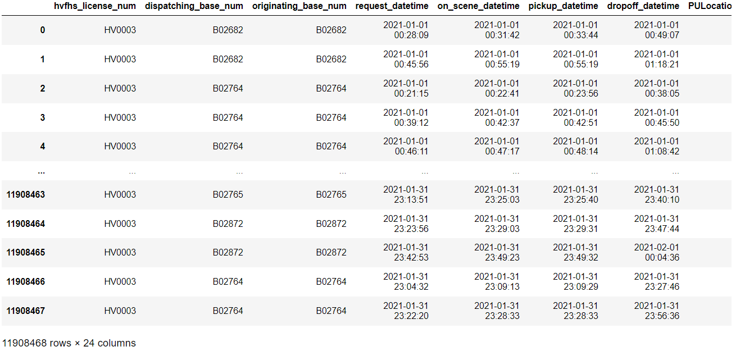
Sample Dataset

Slide 7
Expected Results
What time of the day do users request most taxis?
Average distance traveled by taxi.
Taxi zone where more taxis are requested.
Percentage of wheelchair-accessible vehicles requested.
Insights about shared rides.
UMBC

Slide 8
Scope of Analysis
Rides requested statistics
Delay by UBER to pick up the customer
Company delay per Dispatch Base
Delay by the customer to arrive at the Pick-up location
Customer delay per Dispatch Base
UMBC

Slide 9

OUTCOMES OF ANALYSIS

Slide 10
Monthly Top Dispatching Base as Per Ride Requested
UMBC

Slide 11
No. of Rides Requested Per Hour
UMBC

Slide 12
No. of Rides Requested Per Month
UMBC

Slide 13
No. of Rides Requested Per Season
UMBC

Slide 14
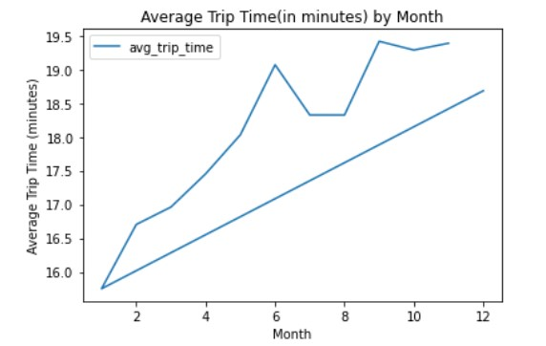
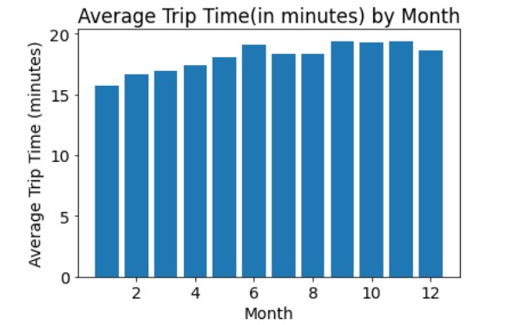
Average Trip Time(in minutes) Per MonthAverage
UMBC

Slide 15
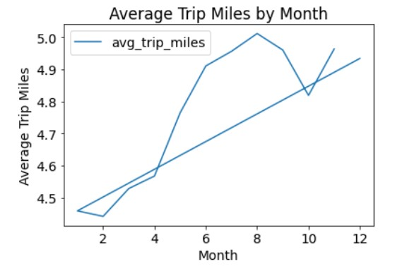
Average Trip Miles Per Month
UMBC

Slide 16
Average Company Delay Per Hour
UMBC

Slide 17
Average Company Delay Per Dispatching Base
UMBC

Slide 18
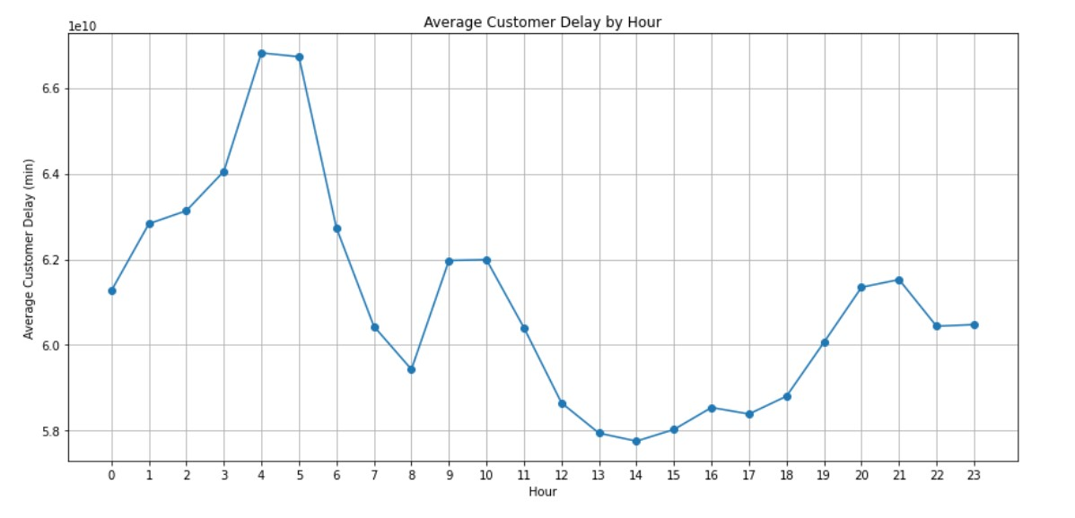
Average Customer Delay Per Hour
UMBC

Slide 19
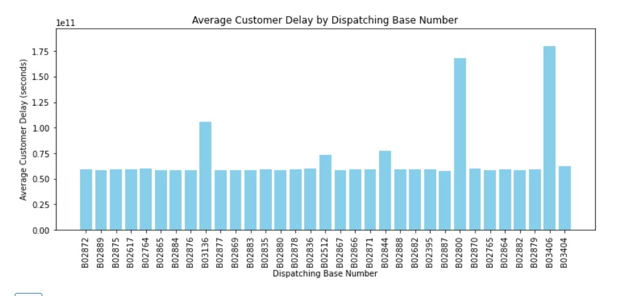
Average Customer Delay Per Dispatching Base
UMBC

Slide 20
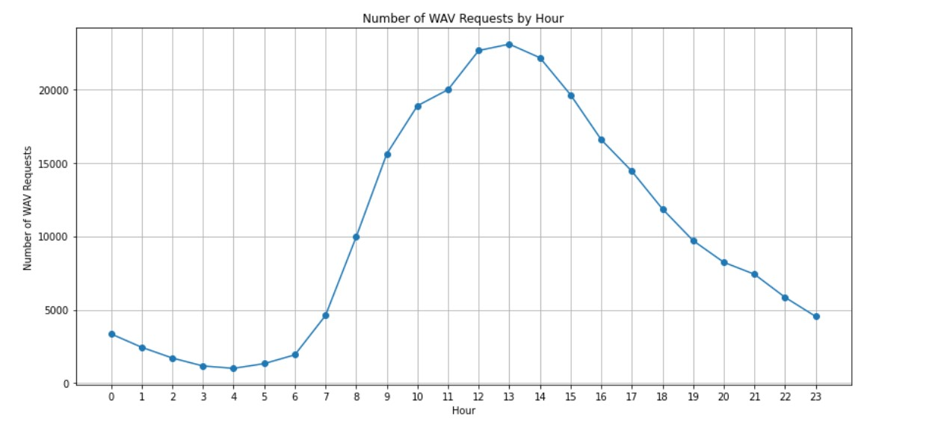
No. of Wheel-Chair Accessible Vehicles Requested Per Hour
UMBC

Slide 21
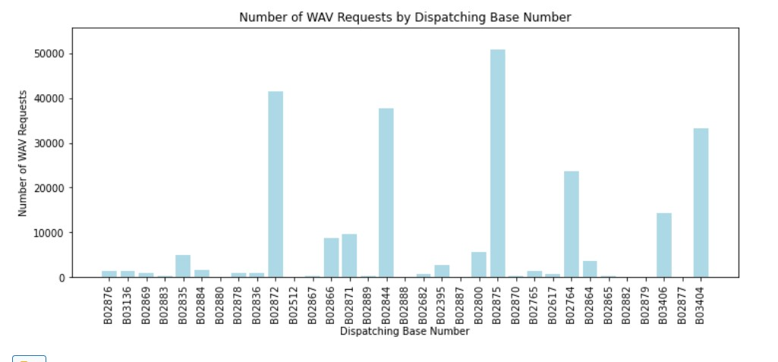
No. of Wheel-Chair Accessible Vehicles Requested Per Dispatching Base
UMBC

Slide 22
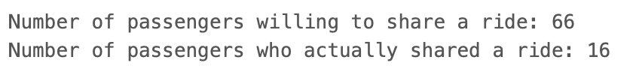
Passengers Willing to Share Ride Vs. Who Actually Shared
UMBC

Slide 23
No. of Willing Shared Requests by Dispatching Base
UMBC

Slide 24
UBER Earnings Per Month
UMBC

Slide 25
UBER Earnings Per Dispatching Base
UMBC

Slide 26


Benefits of Analysis
Analyze ride statics hourly, monthly, and season-wise.
Position its vehicles at the correct Dispatching Base during busy hours.
UMBC

Slide 27
Benefits of Analysis
Analysing Company Delay
Analyzing customer delay
UMBC

Slide 28
Benefits of Analysis
Planning the Maintenance of vehicles
Positioning of Wheelchair Accessible Vehicles
UMBC

Slide 29
References
Uber NYC for-hire vehicles trip data (2021). (2023, February 2). Kaggle. https://www.kaggle.com/datasets/shuhengmo/uber-nyc-forhire-vehicles-trip-data-2021
Get a Vehicle License - TLC. (n.d.). https://www.nyc.gov/site/tlc/vehicles/get-a-vehicle-license.page
Earn Money by Driving or Get a Ride Now | Uber Ireland. (n.d.). Uber. https://www.uber.com/
What is data warehousing on Databricks? (n.d.). Databricks on AWS. https://docs.databricks.com/sql/index.html
PySpark Overview — PySpark 3.4.0 documentation. (n.d.). https://spark.apache.org/docs/latest/api/python/
UMBC

Slide 30
THANK YOU
UMBC

